Slide 1
Charts’ Explanation from ourworldindata.org
Muhammad Shahid Saleem

Slide 2
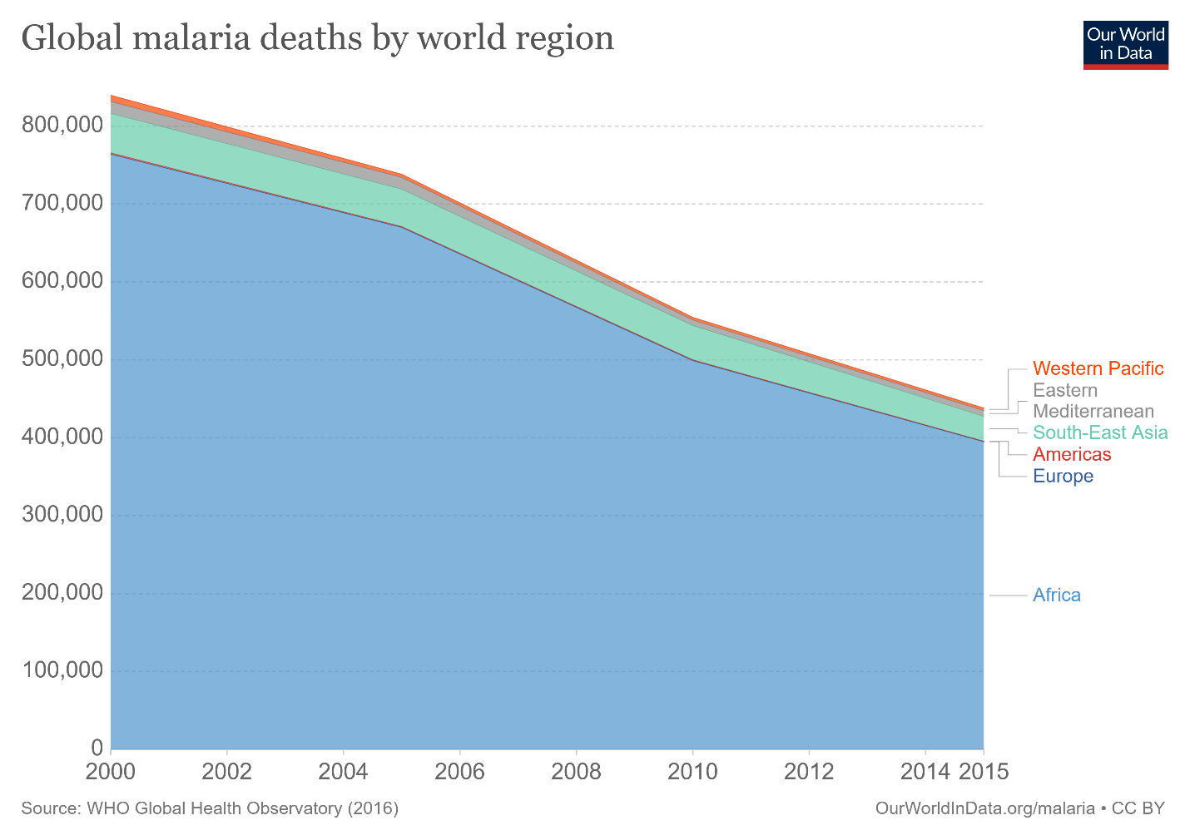
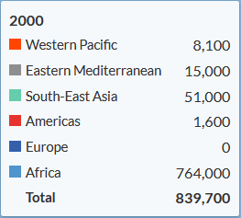
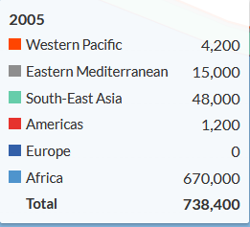
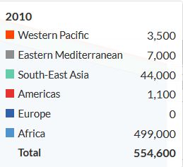
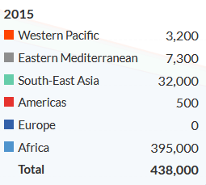
https://ourworldindata.org/malaria-is-killing-fewer-people

Slide 3
Global Malaria Deaths by World Region What does the Chart Say?
In the chart, the horizontal axis indicates the year of the data capture, and on vertical axis area under the curve indicates the number of deaths with step size of 100,000. The data is captured from the year 2000 to 2015 with captures every 5 years.
The chart is indicative of the 6 regions with highest number of deaths due to malaria in 2000 in the African region (764,000) totaling almost 91% of deaths in the world (that is: out of 10 people who died that year due to Malaria in the world , 9 were from Africa) while the lowest number of deaths are in Western Pacific region where total of 8100 deaths occurred contributing 0.96% of the total deaths caused that year. The European region had 0 deaths, and South-East Asian region was on the 3rd number considering the number of deaths caused by Malaria (total 48,000 deaths)
Taking the same data in 2015, the prospects are quite hopeful regarding the Malaria as the total number deaths in the world have dropped 47%. The highest drop occurred in African region where the number of deaths dropped from 764,000 to 395,000 a net drop of almost 48%. While in the Asian region had a drop of 37% deaths from Malaria.
The highest drop in the deaths due to malaria in the world occurred during the period of 2005-2010 with total deaths of 554,600 decreased from 738,400 - a drop of 24%.

Slide 4
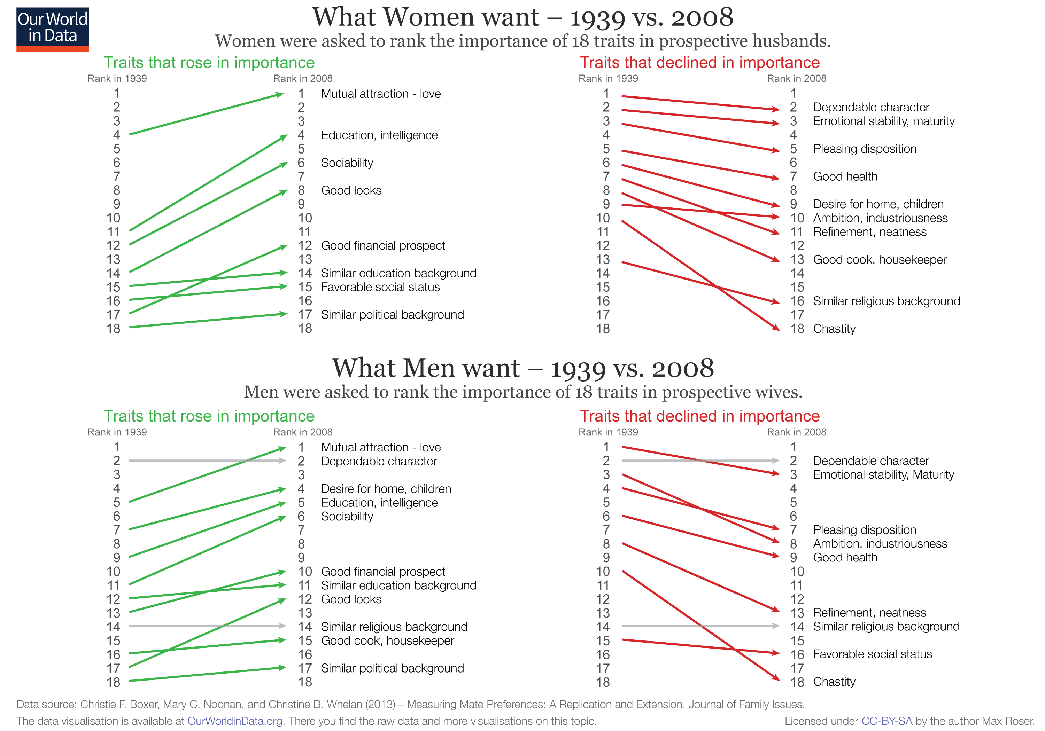
https://ourworldindata.org/what-men-and-women-want-in-marriage

Slide 5
What Women Want in Husbands vs What Men Want in Wives 1939 -2008
The charts indicate the rise, fall, and constant desire of traits that people wanted in their spouse from 1939-2008.
Overall, the biggest trait-decline from 1939-2008 (in Men AND Women) was the Chastity with same decline of 8 ranks from 10th to 18th rank (last trait desire for both men and women).
Traits in rise for men were the Sociability (5 ranks), Good Looks (5 ranks), and Good Financial Prospect (5 ranks) of their potential wives. On the other hand, women gave more importance to the trait of Better Education and Intelligence raising this trait from 11th to 4th rank (7ranks)
Women did not have any constant trait desire in men from 1939 – 2008 while men still kept the Dependable Character on 2nd Rank, and Similar Religious Background on 14th Rank without any change in 70 years.
Men and women raised the Mutual Attraction- Love trait form 5th to 1st rank and 4th to 1st rank, while demoting Emotional Stability, Maturity to 3rd rank, and Dependable Character to 2nd rank from 1st rank respectively.

Slide 6
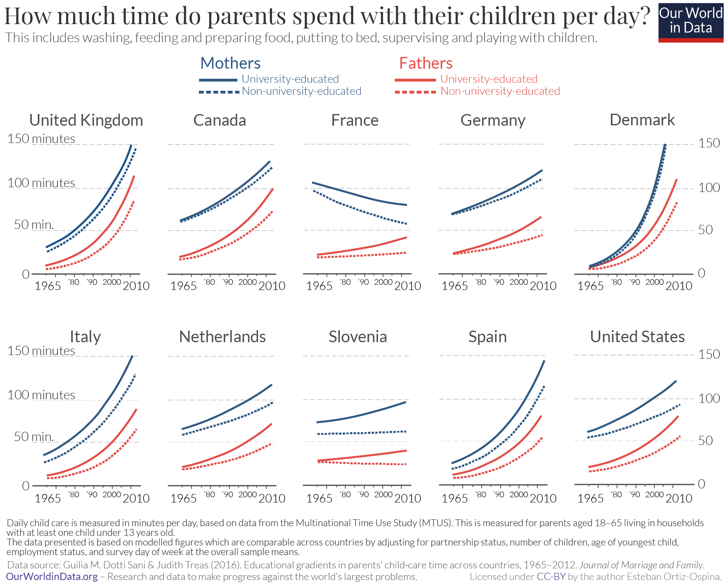
https://ourworldindata.org/parents-time-with-kids

Slide 7
Time Spent by Parents with Their Children Per Day What does the Chart Say?
The data in this chart is collected from 1965-2010 (46 years) and covers 10 countries. For each sub-chart (for a country) the horizontal axis indicates the year of the data while the vertical axis indicates the time spent by parents with their children (in minutes). Each sub chart shows 4 curves two for fathers, and two for mothers (university educated vs non-university educated).
It stands out from the charts that except France, the time spent by mothers (educated as well as non educated) with their children has increased continuously over the period.
Although. It’s worth noting that the difference in time spent by mothers and fathers in France in 1965 was greatest among all countries (difference of almost 80 minutes, mothers spending more time) which has now reduced to 30 minutes for university educated mothers, and fathers vs non-university educated mothers and fathers, respectively.
When considering non-university educated mothers, Denmark tops all countries with non-university educated mothers spending almost qual amount of time as university educated mothers during the period and have grown exponentially from around 5 minutes in 1965 to 150 minutes in year 2005 (highest growth in time spending among all countries).
Non-university educated mothers in Slovenia on the other hand, have spent near-constant amount of time (55 minutes) from 1965 to 2010 whereas non-university educated fathers spending even less from 25 minutes in 1965 to 20 minutes in 2010.

Slide 8
End

